Slide 1
Linear Regression Analysis
The Importance Of Validating Your Linear Model
4/14/20
Dimitri Victor

Slide 2
In a Nutshell
Using RStudio, I found the most effective model using stepwise procedures to predict how much weight(lbs) a 150(lb) male aged 18-23 should be able to bench press dependent on other exercises.
Then using cross validation on a few different models, I was able to verify why certain models were more efficient in predicting future data than others and why it is important to use multiple metrics to test a model's predictive accuracy.

Slide 3
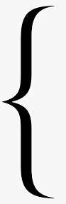
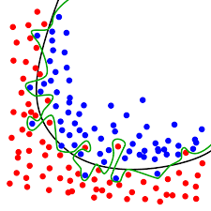
What is Overfitting :
Good performance on the training data, poor generalization to other data.
Overfitting happens when a model learns the detail and noise in the training data to the extent that it negatively impacts the performance of the model on new data.
The model contains more parameters than can be justified by the data.
Additionally, an overfit regression model is tailor-made to fit the random quirks of one sample and is unlikely to fit the random quirks of another sample.
The green line overfits the data because it “fits the noise”
Notes:
https://statisticsbyjim.com/regression/overfitting-regression-models/
https://machinelearningmastery.com/overfitting-and-underfitting-with-machine-learning-algorithms/

Slide 4
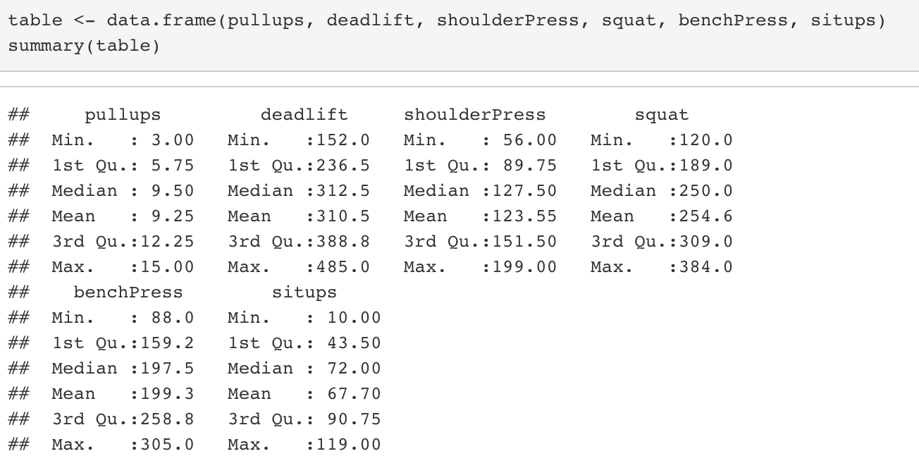
Step 1: Use Data to Create a Linear Model
The table stores the data into a frame that can be used to summarize the dataset.
Pullups, Situps (Repetitions)
Bench Press, Shoulder Press, Squat, Deadlift (Lbs)
For exact data and libraries used, refer to the last slide

Slide 5
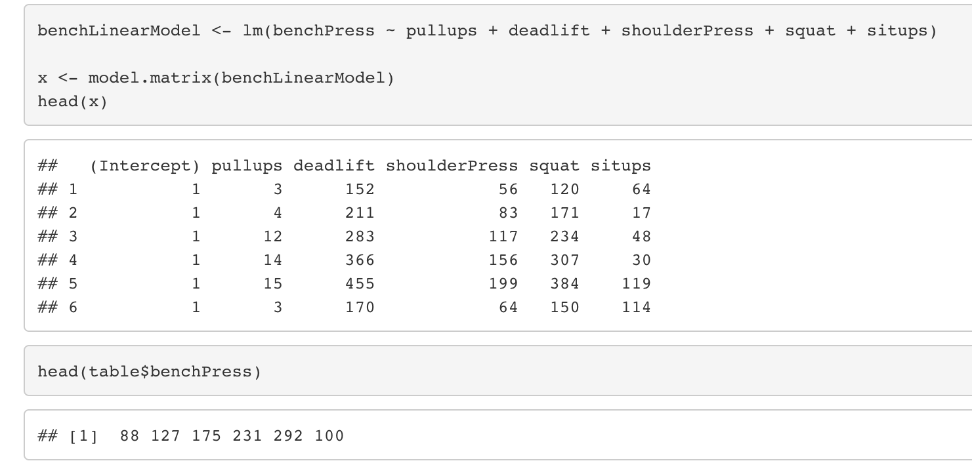
Step 1 Extended
Creating the linear model called benchLinearModel
Response variable: benchPress
Predictors: pullups, deadlifts, shoulderPress, squat, situps
The first six values for each predictor
The predictor variables also called the independent variables are what is being used to predict the response variable. The response variable or what is being predicted is also called the dependent variable.
The first six values for the response

Slide 6
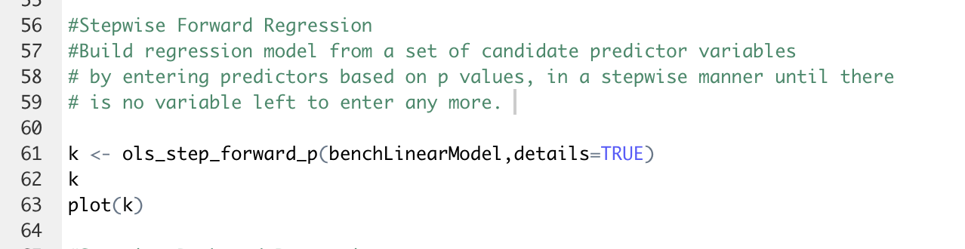
Step 2: Perform Stepwise Regressions To Choose Necessary Predictors
Performs a Forward Stepwise Procedure
But Wait! Why do we perform this procedure, and what even is a Forward Stepwise? See the next slide to find out!

Slide 7
What Is Forward Stepwise
Start with the best single predictor variable by searching through all the individual models and choosing the one with the least residual sum of squares or the model that has the lowest p value only if that model has a p value below the value chosen.
You continue building on the model by adding one predictor variable at a time based on the same criteria for the next best model (2 var model with the next lowest p value)
Continue until some stopping rule is satisfied, for example when all remaining variables have a p-value above some threshold.
Forward selection is a type of stepwise regression which begins with an empty model and adds in variables one by one. In each forward step, you add the one variable that gives the single best improvement to your model.
The program cutoff value is a model with p value above 0.3.
Notes:
https://www.statisticshowto.com/forward-selection/

Slide 8
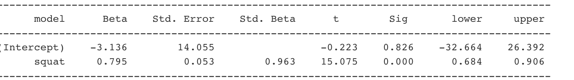
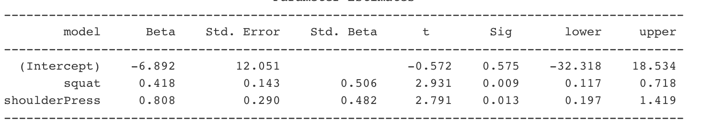
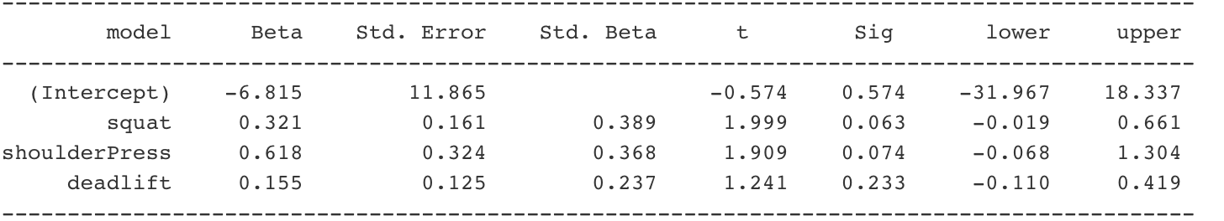
Step 2 Extended
Take note of how the significance levels of the predictors when added to the model are increasing towards 0.3. Also, the significance level of predictors already in the model are increasing as well.
The squat predictor has the lowest significance value and is the first added to the model
The next predictor added is shoulderPress. The significance of this predictor when added to the model is 0 .013 < 0.3
The final predictor added is deadlift. The significance of this predictor when added to the model is 0.233 < 0.3

Slide 9
Is there a Downside to Forward Stepwise?
It makes sense that the more predictors that you have, the greater the chance that one of the predictors is added to your model when it shouldn't be due to random sampling fluctuations. This is especially true when your sample size is not significantly greater than the amount of predictor variables that you have (n>>p).
Each addition of a new feature may render one or more of the already included feature non-significant (p-value>0.05).
As a result, the model may not accurately include predictors that should be in the model, or underpredict the variables that have been affected by the noise.
If you take a look at the previous slide, the procedure becomes less confident of predictors that it may have once been almost certain were related to the model
Take note of the counterintuitive thought process. More predictors does not mean a better predictive model
Notes:
https://link.springer.com/article/10.1186/s40537-018-0143-6
https://repository.upenn.edu/cgi/viewcontent.cgi?article=1377&context=statistics_papers

Slide 10

Is There A Way To Counteract Downsides
Each time you add a predictor to the model you are essentially taking a chance that the variable added will not add any value to your model yet still be added.
In Big Data models with tons of predictors, serious model predictive errors can occur.
How about using expert advice to wean out some predictors that are not fit for the model. This has proven to be a great complement to a models predictive power.
A model with 5 true variables and 5 nuisance variables will predict with much greater accuracy than a model with 5 true variables and 100’s of nuisance variables.
Leaving the calculation strictly up to a machine can prove to be fatal to very large model.

Slide 11
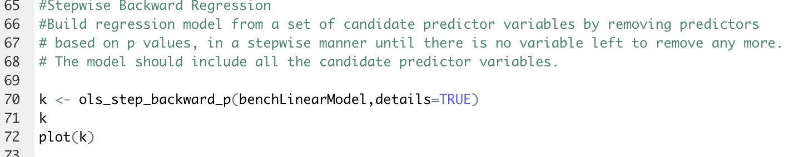
Perform a Backward Elimination Stepwise Regression On The Same Model
Performs a backward stepwise Procedure on benchLinearModel
But What is a Backward Stepwise Regression? View the next slide to find out!

Slide 12
What is Backward Elimination Stepwise Regression
Start with a model that has all the predictors in it, and search for the predictor with the highest significance value
Remove that predictor from the model if its significance level is greater than a value you have chosen. The lower the significance level the more strict the model will be .
Repeat step two until you have a model that consists of predictors with a significance level all above your chose value
Backward elimination is almost opposite to forward stepwise. In that, you start with a model that includes every possible variable and eliminate the extraneous variables one by one.
The default program cuts off values of p greater than 0.3

Slide 13
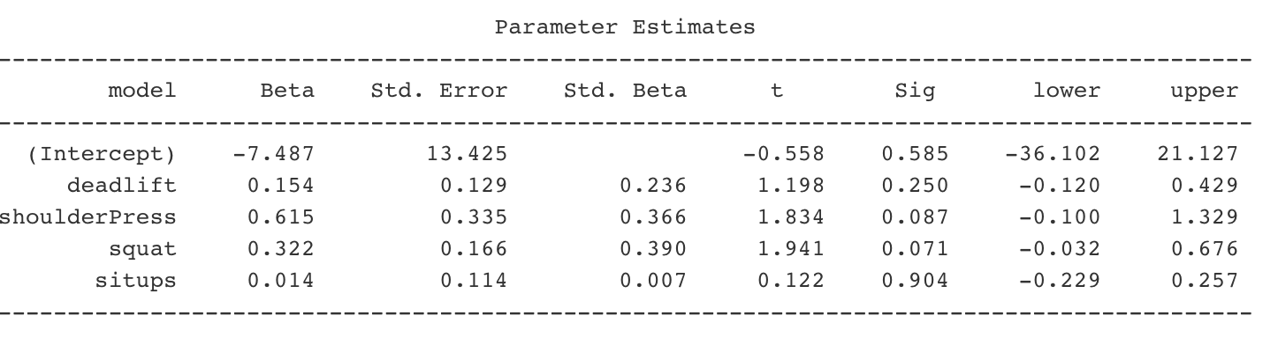
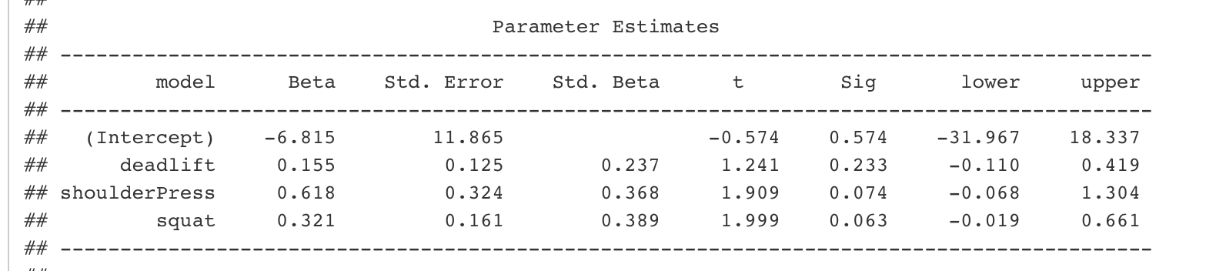
Step 2 Extended
You may have noticed that both forward selection and backwards elimination produced the same model. This is NOT guaranteed.
Notice how all of the predictors except pullups are in the model. Pullups was the first removed.
Notice how situps significance level >> 0.3, clearly showing it should be removed from the model
situps is removed from the model and the remaining predictor’s significance levels are decreased. No more predictors need to be removed because all p <0.3

Slide 14

Is There A Downside?
The downside to backwards selection are similar to those of forward selection. If you have enough predictors you are bound to add one into the model that is not actually beneficial to prediction strength.
On the contrary, using backward stepwise eliminates the case in forward stepwise where adding a predictor the model renders predictors that are already considered significant above 0.3.

Slide 15
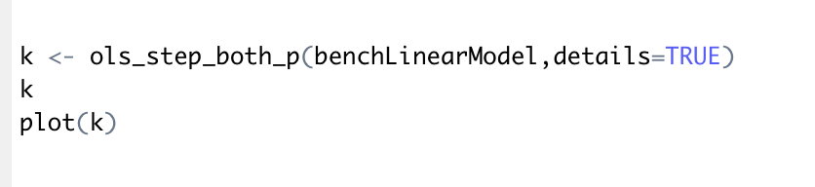
Perform Bidirectional Elimination Stepwise Regression
Performs a bidirectional elimination stepwise regression
What is a Bidirectional Elimination Stepwise Regression? View the next slide to find out.

Slide 16
What is Bidirectional Elimination
Start with the best single predictor variable by searching through all the individual models with 1 predictor and choosing the one with the least residual sum of squares or the model that has the lowest p value only if it is below the p value chosen.
You continue building on the model by adding one predictor variable at a time based on the same criteria for the next best model AND then remove any variables whose significance level may have increased greater than another p value chosen
Continue until their are either no predictors left to add
Bidirectional elimination is essentially a forward selection procedure but with the possibility of deleting a selected variable at each stage, as in the backward elimination, when there are correlations between variables

Slide 17
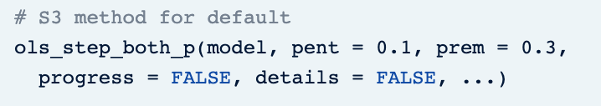
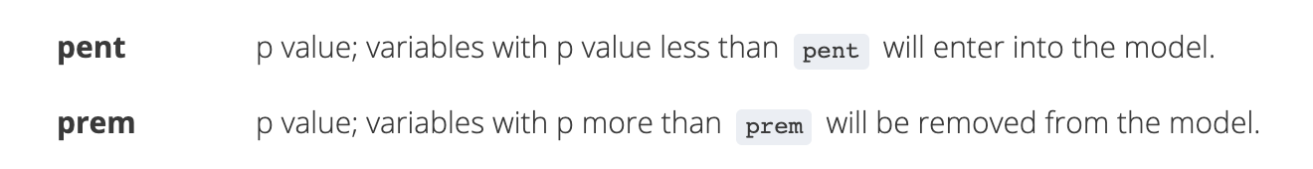
Side Note on Bidirectional Default Values:
The default program cuts off adding any predictors if there significance level is greater than 0 .1 and cuts of the elimination of predictors with significant levels less than 0.3

Slide 18
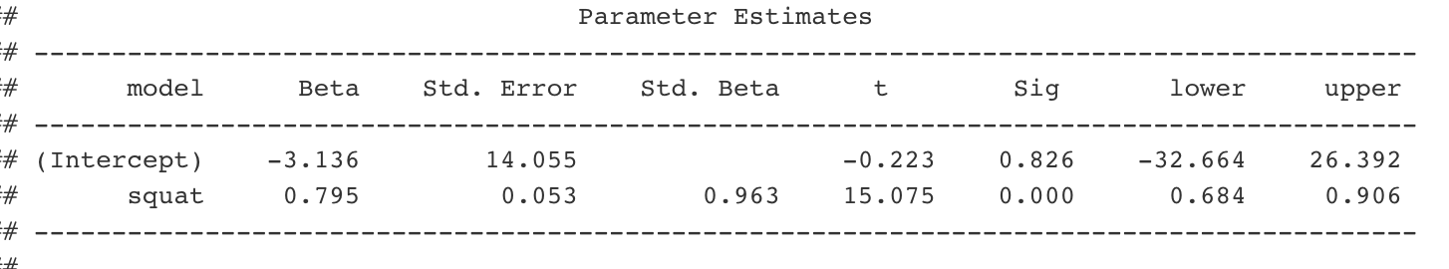
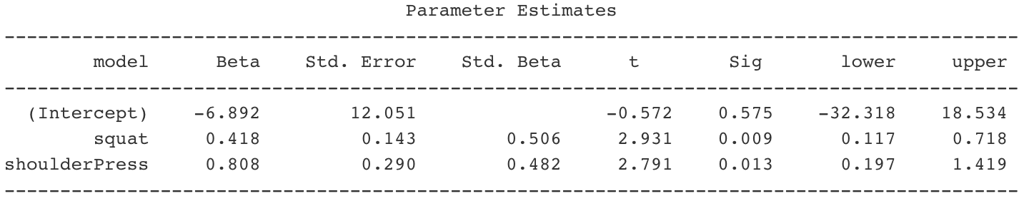
Step 2 Extended
Notice that since the cutoff for adding predictors was decreased to 0.1, the selective process for predictors has become more strict and resulted in 1 less predictor than forward stepwise regression which has a default cutoff value of 0.3.
squat added because it’s p<0.1 and note that there are no predictors with a p>0.3 that should be removed
shoulderPress added because its p<0.1 and no predictors significance value increased to over 0.3

Slide 19
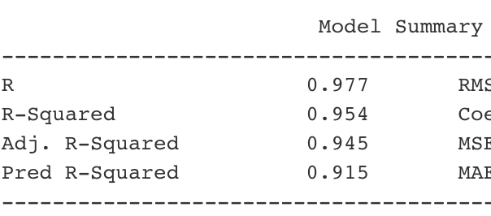
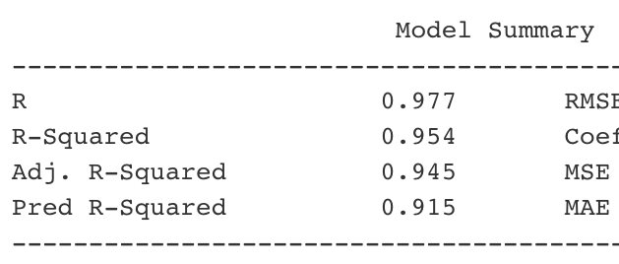
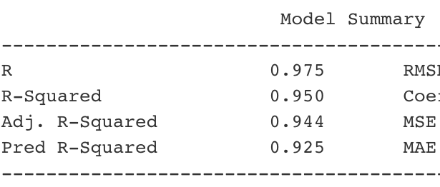
Key Notes About All Three Models
Forward Stepwise Regression Produced A Model With:
Cutoff value of 0.3
Three predictors: squat, shoulderpress, deadlift
Backwards Elimination Stepwise Regression Produced A model With:
Cutoff value of 0.3
Three Predictors: squat, shoulderpress, deadlift
Bidirectional Elimination Stepwise Regression Produced A Model With:
Elimination cutoff of 0.3 and addition cutoff of 0.1
Two Predictors: squat, shoulderPress
Notice how the third model has the lowest R-Squared Value and the least amount of predictors

Slide 20
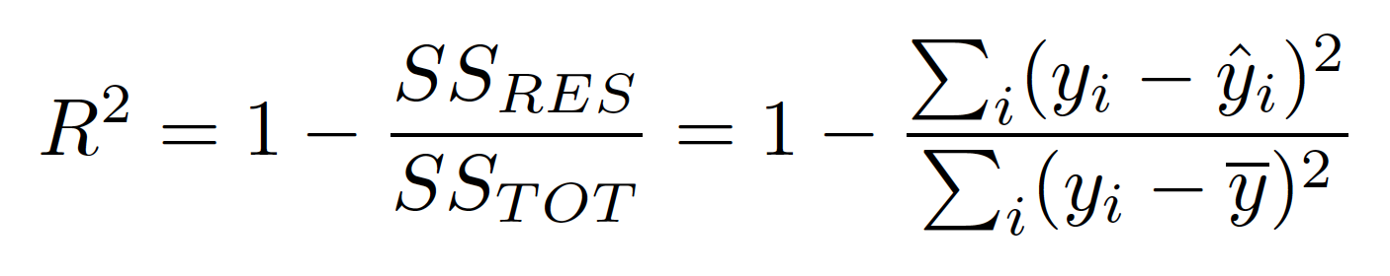
Side Note: What is R-Squared
The Coefficient Of Determination (R-Squared) is a key output of regression analysis. It is interpreted as the proportion of the variance in the dependent variable that is predictable from the independent variable.
The value in your statistical output is an estimate of the population value that is based on your sample.
It ranges from O-1, 1 representing an almost perfect model fit
Notes:
https://stattrek.com/statistics/dictionary.aspx?definition=coefficient_of_determination

Slide 21
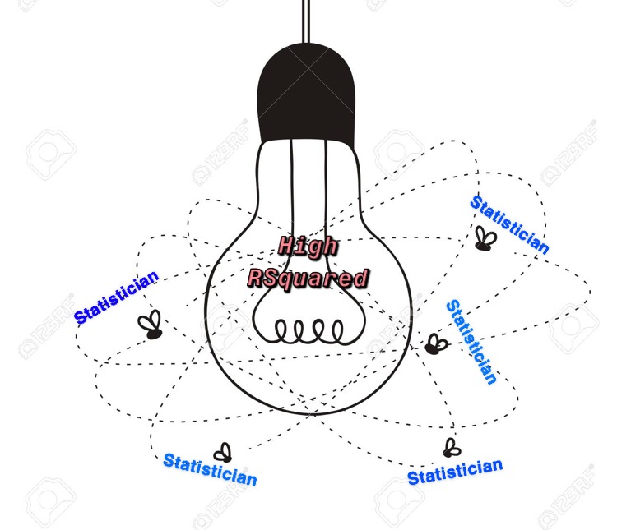
Side Note: How Can It Cause Overfitting
A high R-Squared is not bad , but overfitting can occur if statisticians chase the elusiveness of a high R- Squared value. Your model may produce a high R-Squared, but it could be a result of “fitting the noise”. R-Squared alone is a weak measure of a models predictive strength .

Slide 22
Step 3: K Fold Cross Validation: Checking For Overfitting
Shuffle the dataset randomly.
Split the dataset into k groups
For each unique group:
Take the group as a hold out or test data set
Take the remaining groups as a training data set
Fit a model on the training set and evaluate it on the test set
Retain the evaluation score and discard the model
Summarize the skill of the model using the sample of model evaluation scores
Cross-validation is primarily used in applied machine learning to estimate the skill of a machine learning model on unseen data. Given a limited sample, it helps make predictions on how well the model is expected to perform to make future predictions on data.
Notes:
https://machinelearningmastery.com/k-fold-cross-validation/

Slide 23
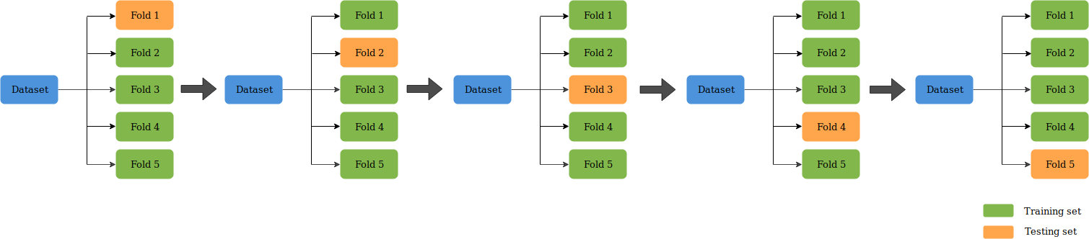
K Fold Cross Validation: Checking For Overfitting
Notes:
https://medium.com/datadriveninvestor/k-fold-cross-validation-6b8518070833

Slide 24
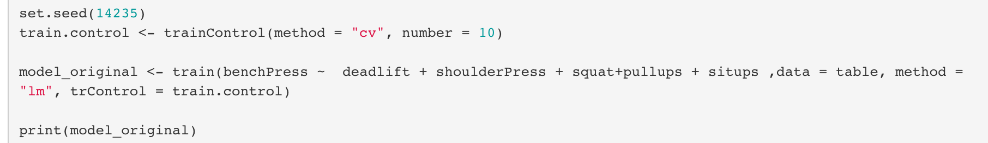
Performing K Fold Cross Validation On The Original Model
Note that this # is the value we chose for K. Our data is split into 10 “buckets” or folds. If we have 20 observations for each predictor and ten folds there are 20/10 = 2 data points per fold.
Note that there are 5 predictors in our original model
This is the code for conducting a cross validation on our original model

Slide 25
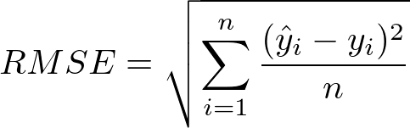
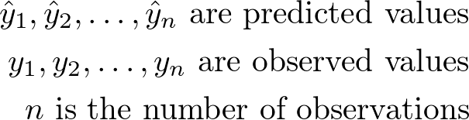

What does K Fold Cross Validation Produce
RMSE: Root Mean Square Error
Root Mean Square Error (RMSE) is the standard deviation of the residuals (prediction errors). Residuals are a measure of how far from the regression line data points are;
R-Squared: Coefficient of determination
MAE: Mean Absolute Error
MAE measures the average magnitude of the errors in a set of predictions, without considering their direction. It’s the average over the test sample of the absolute differences between prediction and actual observation where all individual differences have equal weight.
This is the RMSE and MAE that is computed for each k- fold validation. If it was a n fold validation these values would be computed n times.
A lower RMSE and MAE is desirable. Comparing two models with the same predictors, lower values show less overfitting
Notes:
https://www.statisticshowto.com/rmse/

Slide 26
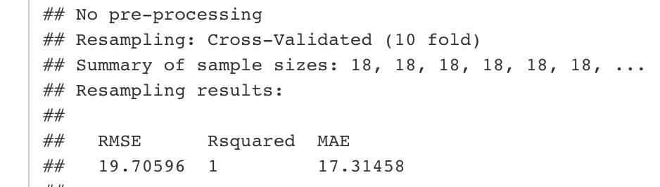
Output For Original Model Cross Validation
The sample that each “bucket” is tested against
2 data points per bucket
18 data points left over
2+18 = 20 total data points
The metrics that the code produces
The R-Squared in this model and the others is 1. Note that this in not always the case. In THIS sample, if I were to have chosen a greater k value, the R-Squared would have decreased.

Slide 27
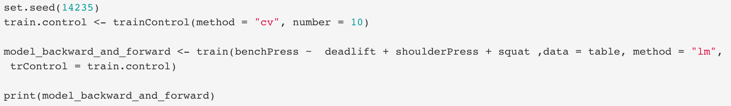
Performing K Fold Cross Validation On The Forward and Backward Stepwise Model’s
Note that there are only 3 predictors that our outputs deemed worth adding to the model
Both stepwise functions produced the same predictors for our ideal model so the same metrics will be produced from a cross validation. Forward stepwise and backwards elimination stepwise don’t always produce the same predictors

Slide 28
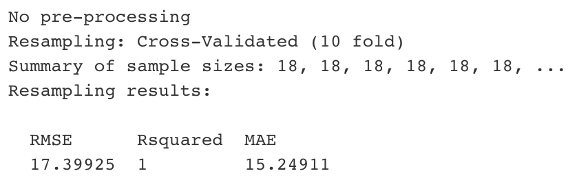
Performing K Fold Cross Validation On The Forward and Backward Stepwise Model’s
The outputs that the code Produces

Slide 29
Performing K Fold Cross Validation On The Bidirectional Model
Note that there are only the 2 predictors that our output deemed worth adding to the model

Slide 30
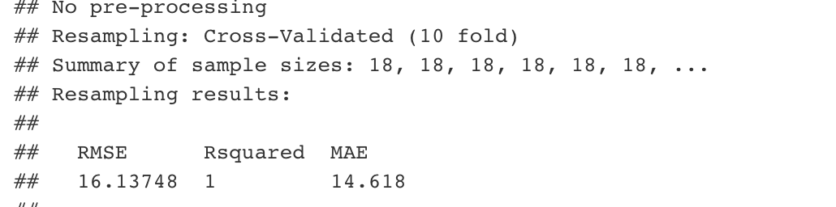
Output For Bidirectional Cross Validation
The outputs that the code Produces

Slide 31


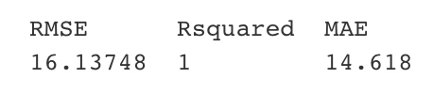
Key Notes About All 3 Cross Validated Models
Original Mode (5 predictors):
Forward/Backwards Model (3 Predictors):
Bidirectional Model (2 Predictors):

Slide 32
Key Notes About All 3 Cross Validated Models
The original R-Squared values for the model with 3 predictors was higher than that of 2 predictors, yet the RMSE and MAE is greater. This clearly shows how forward/backwise stepwise chose a model that overfitted the data because the Bidirectional Stepwise procedure chose a model that has less predictors and a greater predictive capability
Don't mistake this example with the claim that less predictors means a greater predictive capability. There is an ideal amount of predictors for every model and in this example it is a coincidence that the three models had an increased predictive power with EVERY decrease in predictors.

Slide 33
One Single Metric Is Not Enough To Validate A Model’s Predictive Strength!
RMSE: Root Mean Square Error
R Squared: Coefficient of determination
MAE: Mean Absolute Error
These are a few of many metrics that can be used to find the most predictive model
BUT
In combination, the strength and validity of the model greatly increases

Slide 34
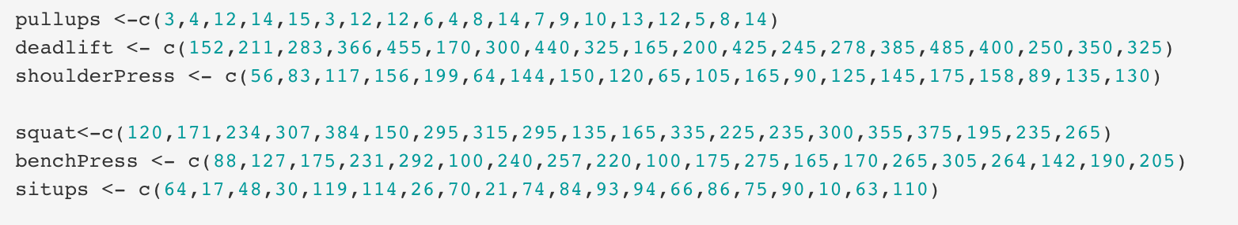
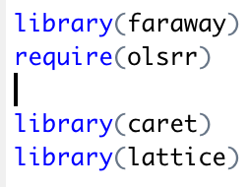
Extra Information:
The data used to create my model
Libraries and packages used

Slide 35
Sources:
https://www.statisticshowto.com/rmse/
https://medium.com/datadriveninvestor/k-fold-cross-validation-6b8518070833
https://machinelearningmastery.com/k-fold-cross-validation/
https://stattrek.com/statistics/dictionary.aspx?definition=coefficient_of_determination
https://link.springer.com/article/10.1186/s40537-018-0143-6
https://repository.upenn.edu/cgi/viewcontent.cgi?article=1377&context=statistics_papers
https://www.statisticshowto.com/forward-selection/
https://statisticsbyjim.com/regression/overfitting-regression-models/
https://machinelearningmastery.com/overfitting-and-underfitting-with-machine-learning-algorithms/
Special Mention: Professor Jack Mardekian Rutgers University

